Slide 1
Convolutional Neural Networks – use in Vision and NLP
(Based onhttp://brohrer.github.io/how_convolutional_neural_networks_work.html
and the survey paper by Yoav Goldberg)

Slide 2
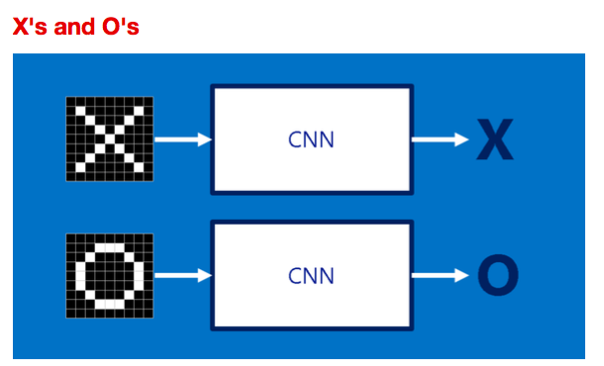
Simple Example: Whether an image is an X or an O?

Slide 3
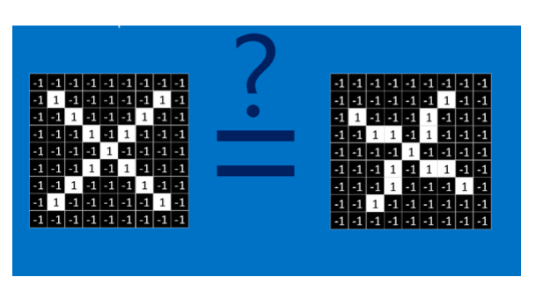
Challenge: We would like to be able to see X’s and O’s even if they’re shifted, shrunken, slightly rotated or deformed.

Slide 4
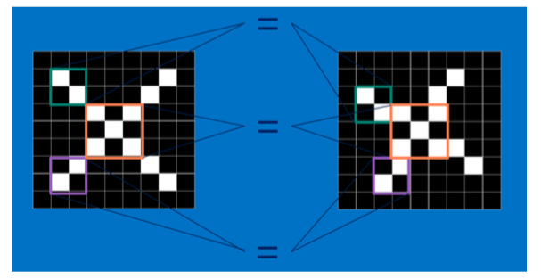
CNNs compare images piece by piece. The pieces that it looks for are called features.

Slide 5
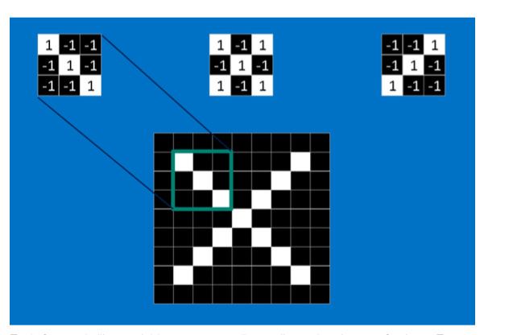
Each feature is like a mini-image—a small two-dimensional array of values. Features match common aspects of the images. In the case of X images, features consisting of diagonal lines and a crossing capture all the important characteristics of most X’s.

Slide 6
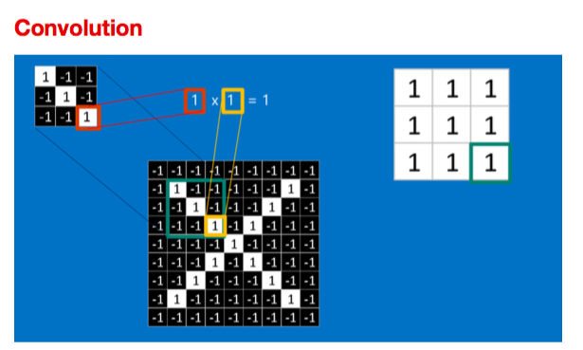
Convolution in one location

Slide 7
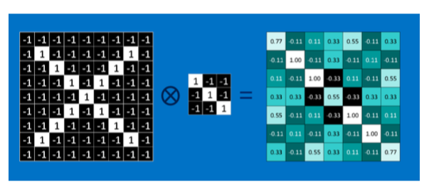
Convolution over the image

Slide 8
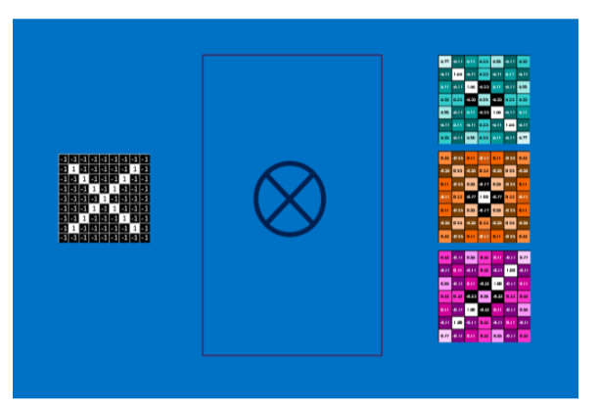
Convolution with multiple filters produces a stack of images

Slide 9
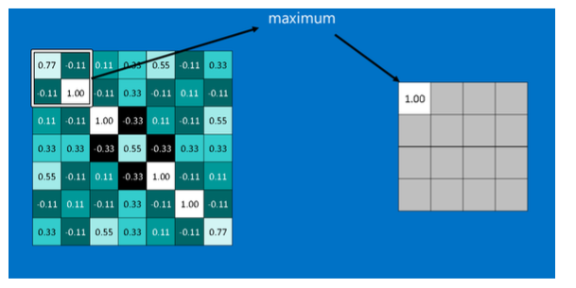
Pooling: take large images and shrink them down while preserving the most important information in them. (Parameters: Window Size and stride)

Slide 10
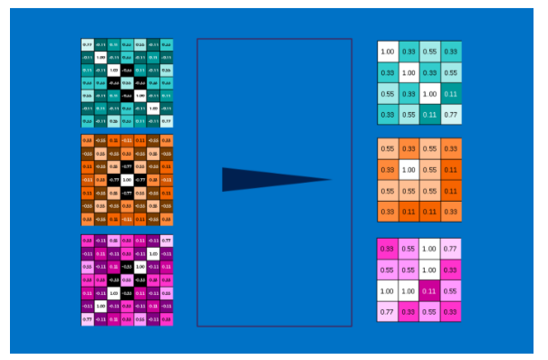
Maxpooling on the stack of images

Slide 11
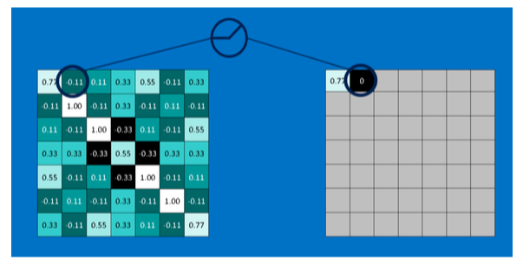
RELU layer

Slide 12
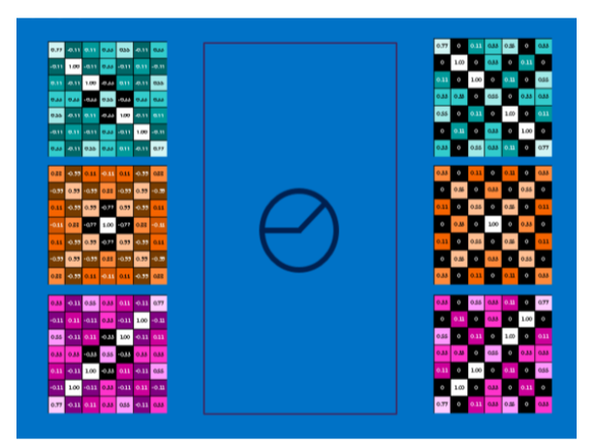
RELU applied to a stack of images

Slide 13
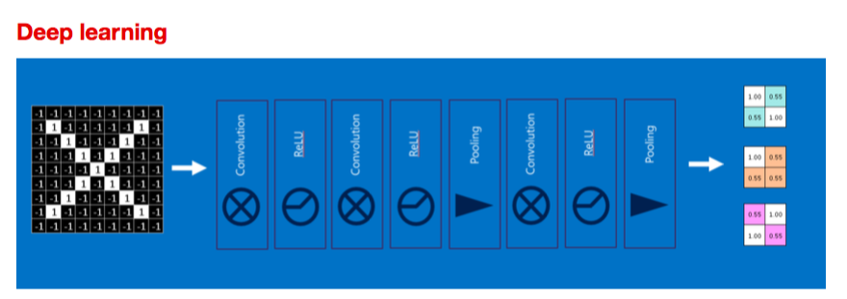
Stacking of modules

Slide 14
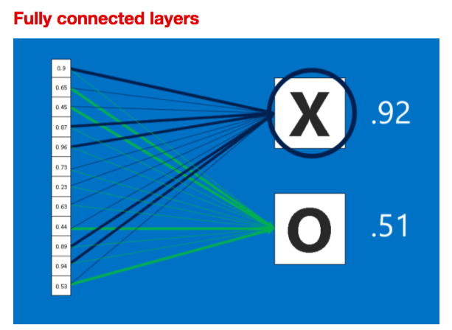
Fully connected layer

Slide 15
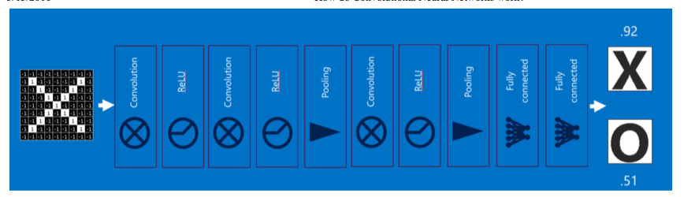
Multiple layers of different kinds of modules

Slide 16
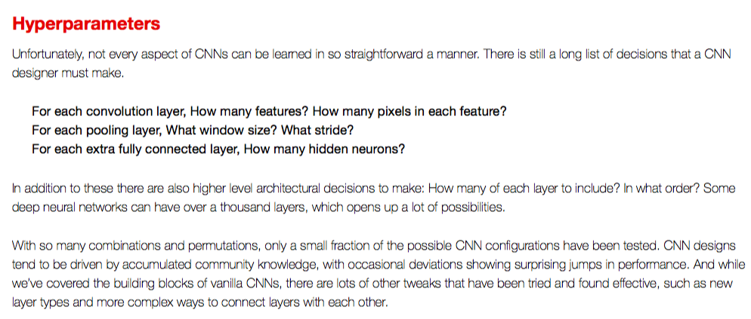
Hyperparamaters

Slide 17
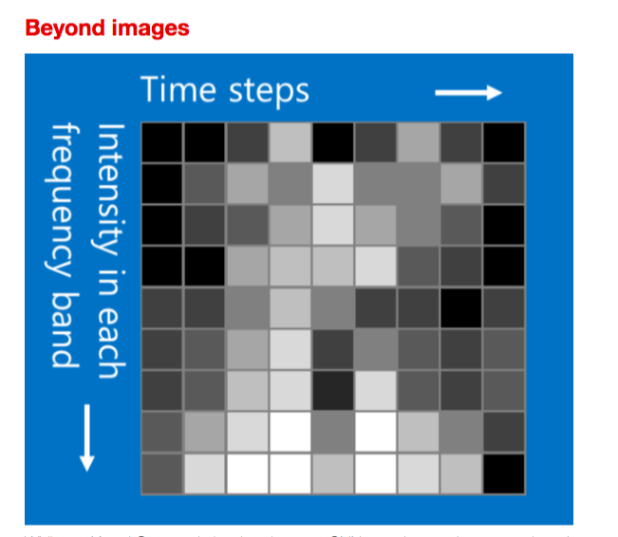

Slide 18
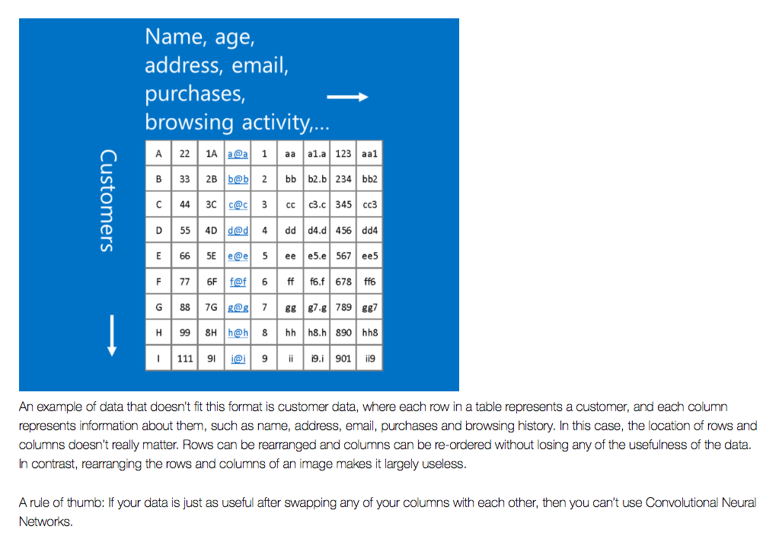

Slide 19
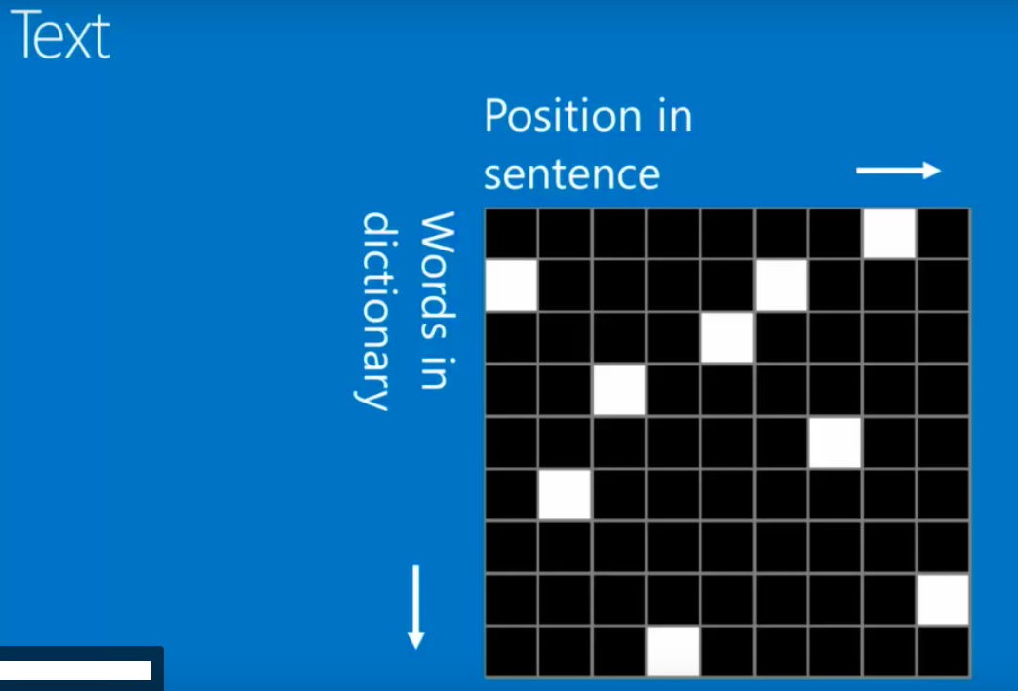

Slide 20
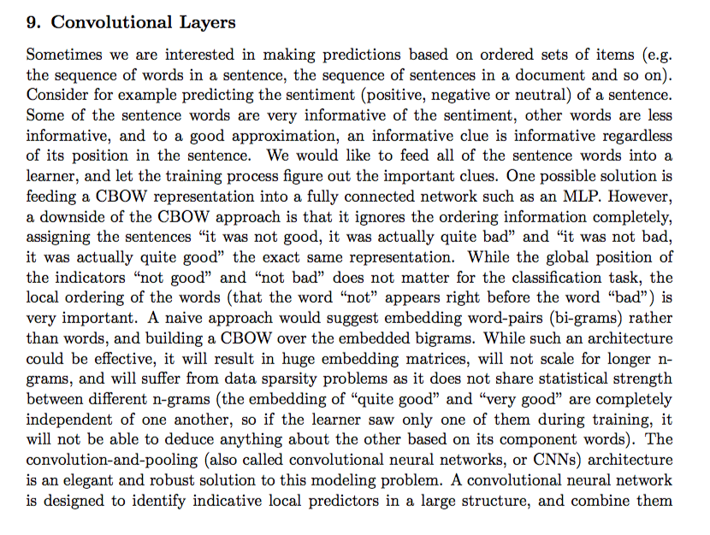

Slide 21
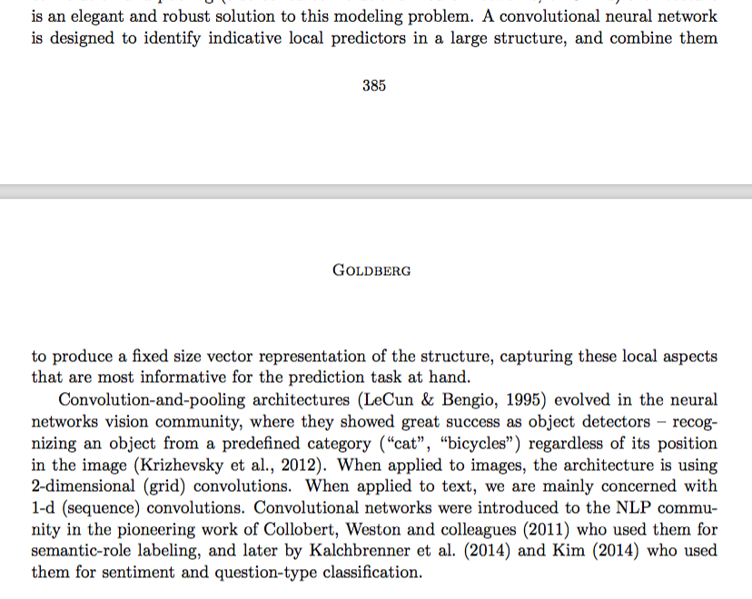

Slide 22
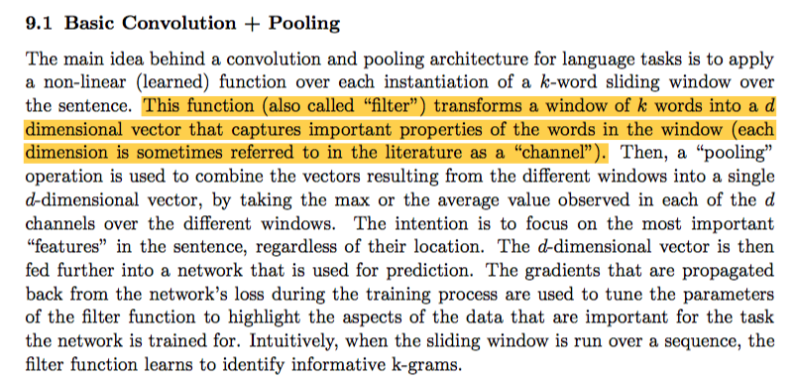
Convolution and Pooling in NLP

Slide 23
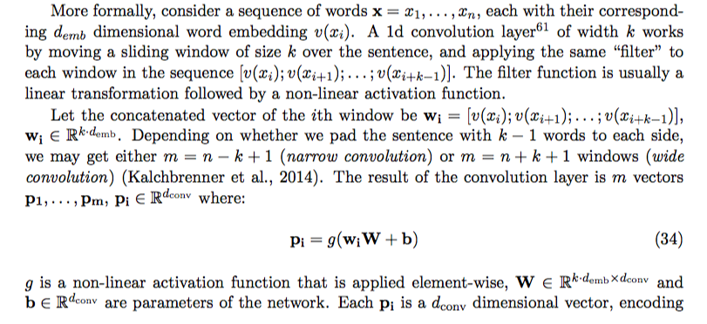
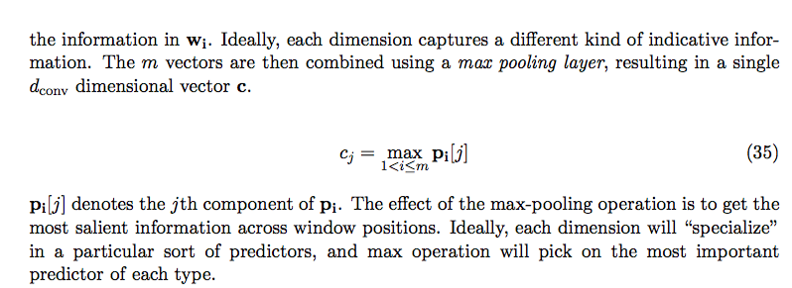

Slide 24
